Slide 1
Chapter 6
Interest Rate Futures

Slide 2
Day Count Convention
Defines:
  the period of time to which the interest rate applies
  The period of time used to calculate accrued interest (relevant when the instrument is bought of sold

Slide 3
Day Count Conventions in the U.S.
Treasury Bonds: | Actual/Actual (in period)
Corporate Bonds: | 30/360
Money Market Instruments: | Actual/360

Slide 4
Examples
Bond: 8% Actual/ Actual in period.
  4% is earned between coupon payment dates. Accruals on an Actual basis. When coupons are paid on March 1 and Sept 1, how much interest is earned between March 1 and April 1?
Bond: 8% 30/360
  Assumes 30 days per month and 360 days per year. When coupons are paid on March 1 and Sept 1, how much interest is earned between March 1 and April 1?

Slide 5
Examples continued
T-Bill: 8% Actual/360:
  8% is earned in 360 days. Accrual calculated by dividing the actual number of days in the period by 360. How much interest is earned between March 1 and April 1?

Slide 6
The February Effect (Business Snapshot 6.1)
How many days of interest are earned between February 28, 2021 and March 1, 2021 when
  day count is Actual/Actual in period?
  day count is 30/360?

Slide 7
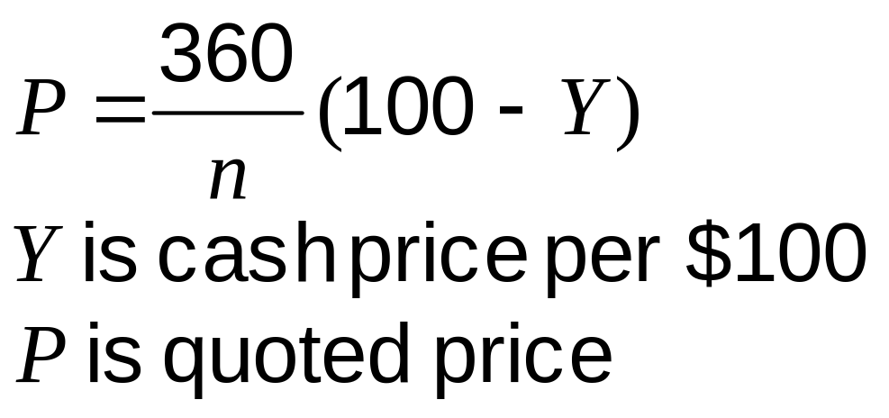
Treasury Bill Prices in the US

Slide 8
Treasury Bond Price Quotes in the U.S
Cash price = Quoted price + Accrued Interest

Slide 9
Treasury Bond Futures
Cash price received by party with short position =
Most recent settlement price × Conversion factor + Accrued interest

Slide 10
Example
Most recent settlement price = 90.00
Conversion factor of bond delivered = 1.3800
Accrued interest on bond =3.00
Price received for bond is 1.3800×90.00+3.00 = $127.20 per $100 of principal

Slide 11
Conversion Factor
The conversion factor for a bond is approximately equal to the value of the bond on the assumption that the yield curve is flat at 6% with semiannual compounding

Slide 12
CBOT T-Bonds & T-Notes
Factors that affect the futures price:
  Delivery can be made any time during the delivery month
  Any of a range of eligible bonds can be delivered
  The wild card play

Slide 13
Eurodollar Futures
Eurodollar futures are futures on the 3-month LIBOR rate
One contract is on the rate earned on $1 million
A change of one basis point or 0.01 in a Eurodollar futures quote corresponds to a contract price change of $25

Slide 14
Eurodollar Futures continued
A Eurodollar futures contract is settled in cash
When it expires the final settlement price is 100 minus 3-month LIBOR
The LIBOR rate is observed two days before the third Wednesday of the month

Slide 15
Eurodollar Futures Example (Table 6.2)
Date | Trade Price | Settlement futures price | Change | Gain per contract
May 21 | 99.720
May 21 |  | 99.715 | -0.005 | -12.50
May 22 |  | 99.665 | -0.050 | -125
……. | …… | …… | …… | ……
Sept 14 |  | 99.810 | +0.010 | +25
Total |  |  | +0.090 | +225

Slide 16
Hedging
The contract can be used for hedging in a situation where a 3-month interest rate on $1 million, linked to LIBOR, is due to be received for a 3-month period starting on Sept 14
What rate does the contract lock in?

Slide 17
SOFR Futures
The one-month SOFR futures is designed to be as similar as possible to the one-month Fed Fund futures contract and is based on an arithmetic average of overnight rates
The three-month SOFR futures is designed to be as similar as possible to the three-month Eurodollar futures and is based on the result of compounding overnight rates

Slide 18
3-Month Eurodollar Futures vs. 3-month SOFR Futures
The 3-month Eurodollar futures for a contract month is settled on the third Wednesday of the month and equal to the 3-month LIBOR rate observed two days earlier
The 3-month SOFR futures for the same contract month is settled 3-months later (when all the relevant overnight rates have been observed)

Slide 19
Using SOFR for Hedging (Example 6.3)
A company has agreed to pay three month SOFR plus 200 basis points on $100 million for three months starting on December 16, 2021
The December SOFR futures price is 99.990
What rate can the company lock in?

Slide 20
Forward Rates
We can usually assume that forward prices equal futures prices
For interest rate futures that last more than about two years we cannot do this

Slide 21
There are Two Reasons
Futures is settled daily whereas FRA is settled once (true for both Eurodollar and SOFR)
Futures is settled at the beginning of the underlying three-month period; FRA is settled at the end of the underlying three- month period (true for Eurodollar)

Slide 22
Convexity adjustment
Forward Rate = Futures Rate − c
where c is referred to as a convexity adjustment

Slide 23
Extending Zero Curves
Forward rates can be used to bootstrap the zero curve

Slide 24
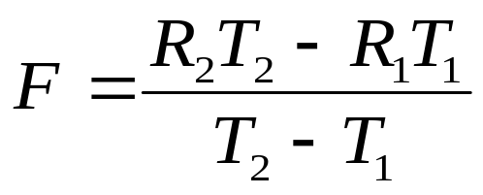
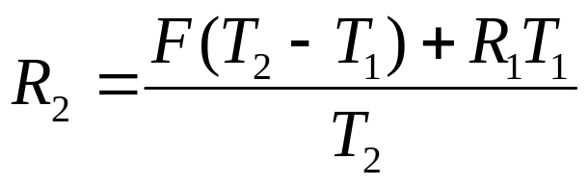
Example (equation 6.2)
so that
If the 400-day zero rate has been calculated as 4.80% and the forward rate for the period between 400 and 491 days is 5.30 the 491 day rate is 4.893%

Slide 25
Duration Matching
This involves hedging against interest rate risk by matching the durations of assets and liabilities
It provides protection against small parallel shifts in the zero curve

Slide 26
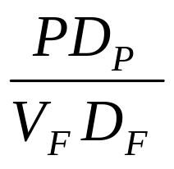
Duration-Based Hedge Ratio (equation 6.3)
V_{F} | Contract price for interest rate futures
D_{F} | Duration of asset underlying futures at maturity
P | Value of portfolio being hedged
D_{P} | Duration of portfolio at hedge maturity

Slide 27
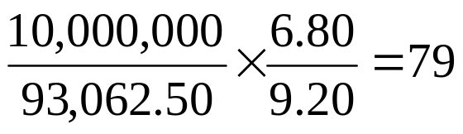
Example
It is August. A fund manager has $10 million invested in a portfolio of government bonds with a duration of 6.80 years and wants to hedge against interest rate moves between August and December
The manager decides to use December T-bond futures. The futures price is 93-02 or 93.0625 and the duration of the cheapest to deliver bond will be 9.2 years at the futures contract maturity
The number of contracts that should be shorted is

Slide 28
Limitations of Duration-Based Hedging
Assumes that only parallel shift in yield curve take place
Assumes that yield curve changes are small
When T-Bond futures is used assumes there will be no change in the cheapest-to-deliver bond

Slide 29
GAP Management (Business Snapshot 6.3)
This is a more sophisticated approach used by banks to hedge interest rate. It involves
  Bucketing the zero curve
  Hedging exposure to situation where rates corresponding to one bucket change and all other rates stay the same

Slide 30
Liquidity Risk
If a bank funds long term assets with short term liabilities such as commercial paper, it can use FRAs, futures, and swaps to hedge its interest rate exposure
But it still has a liquidity exposure.
It may find it impossible to roll over the commercial paper if the market loses confidence in the bank
Northern Rock is an example of this type of liquidity problem

